Slide 1
20
Cash and Liquidity Management

Slide 2

Chapter 20 – Index of Sample Problems
Slide # 02 - 09 Float
Slide # 10 - 11 Cost of float
Slide # 12 - 16 Lockbox net present value
Slide # 17 - 21 BAT model
Slide # 22 - 25 Miller-Orr model

Slide 3
2: Float
On an average day, your firm receives 50 checks. These checks, on average, are worth $250 each. The average collection delay is 3 days. Also each day, your firm writes about 25 checks. These checks are worth an average of $400 and clear your bank in an average of 6 days.
What is the amount of the collection float?
What is the amount of the disbursement float?
What is the amount of the net float?

Slide 4
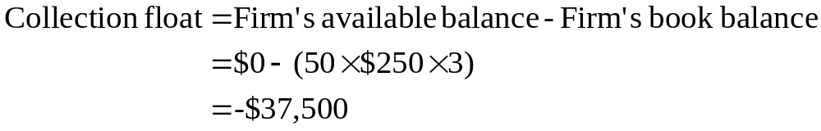
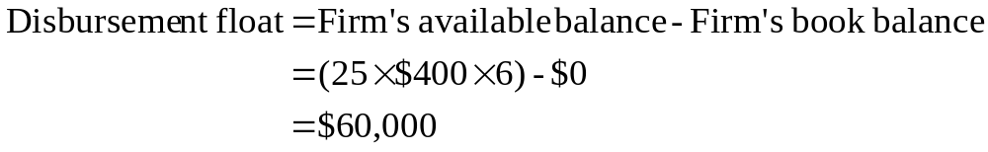
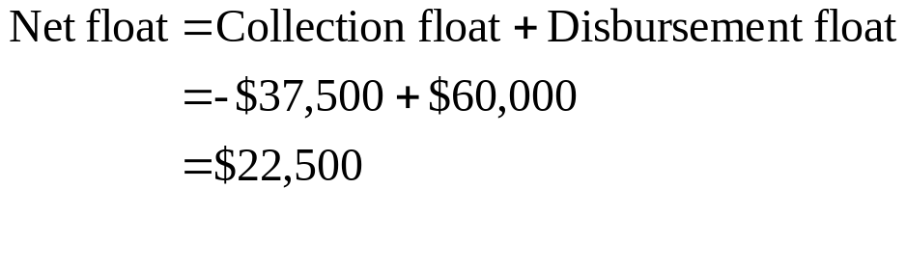
3: Float

Slide 5
4: Float
Your firm has decided to contract with only three customers who each pay you monthly as follows:
Customer Check Amount Collection delay
A $60,000 4 days
B $40,000 5 days
C $50,000 2 days
What is the average daily float amount?

Slide 6
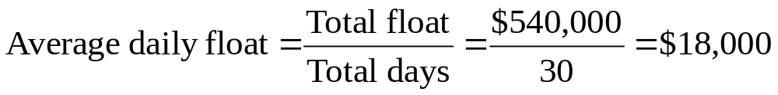
5: Float
Item Amount | Delay | Total float
$60,000 | × 4 | = $240,000
$40,000 | × 5 | = $200,000
$50,000 | × 2 | = $100,000
 | Total: | $540,000

Slide 7
6: Float
Your firm has decided to contract with only three customers who each pay you monthly as follows:
Customer Check Amount Collection delay
A $60,000 4 days
B $40,000 5 days
C $50,000 2 days
What is the amount of the average daily receipts?
What is the weighted average delay?

Slide 8
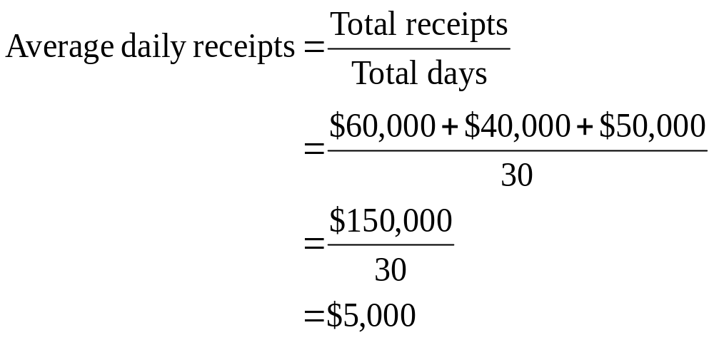
7: Float

Slide 9
8: Float
Amount | Weight | Delay | Weighted average delay
$ 60,000 | 60/150 = .4000 | 4 | .400 × 4 = 1.6000
$ 40,000 | 40/150 = .2667 | 5 | .2667 × 5 = 1.3335
$ 50,000 | 50/150 = .3333 | 2 | .3333 × 2 = .6666
$150,000 | 1.000 |  | Total = 3.6001

Slide 10

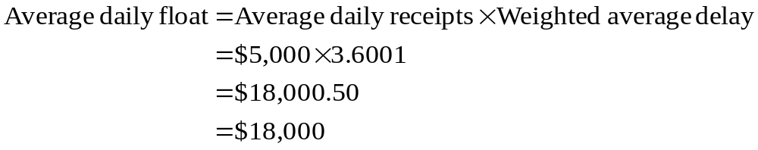
9: Float

Slide 11
10: Cost of float
The Breadwinner Co. receives an average of $1,200 a day in checks. The average delay in clearing is 4 days. Currently, the applicable interest rate per day is .03%.
What the is the present value of the float?
What is the most this firm should pay to eliminate its collection float entirely?
What is the highest daily fee this firm should pay to eliminate its collection float entirely?

Slide 12
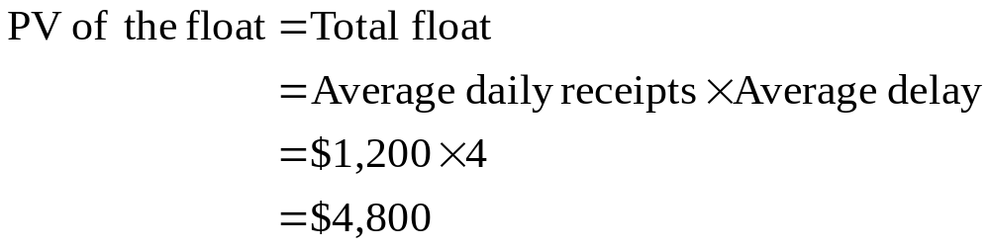
11: Cost of float
What the is the present value of the float?

Slide 13
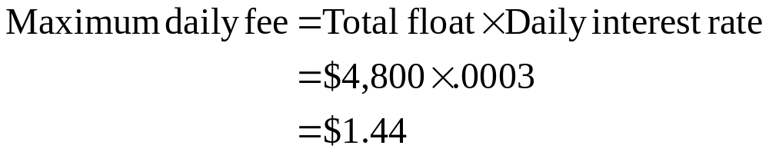
12: Cost of float
What is the most this firm should pay to eliminate its collection float entirely?
What is the highest daily fee this firm should pay to eliminate its collection float entirely?

Slide 14
13: Lockbox net present value
You are considering implementing a lockbox system and have gathered this information:
Average daily lockbox payments = 1,200
Average size of payment = $750
Daily interest rate of Treasury bills = .01%
Bank charge per check = $.21
Reduction in mail time = 1.5 days
Reduction in processing time = 1.0 day
Reduction in clearing time = .5 day
What is the NPV of this lockbox arrangement?

Slide 15
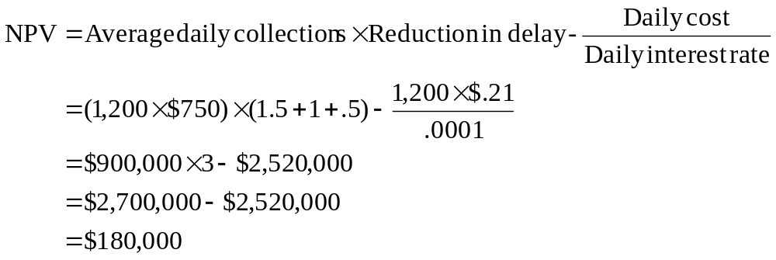
14: Lockbox net present value
See the next slide for another approach.

Slide 16
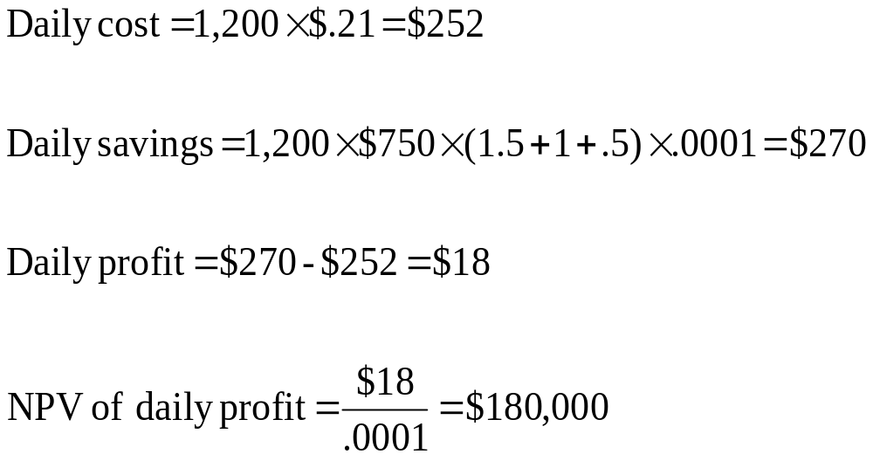
15: Lockbox net present value
See the next slide for a slightly different approach.

Slide 17
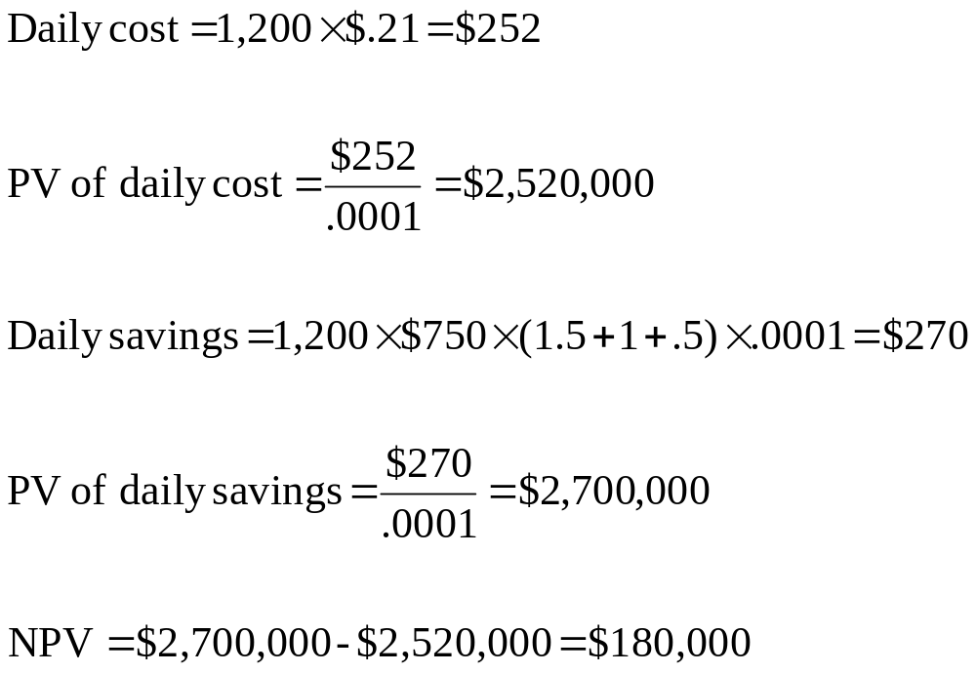
16: Lockbox

Slide 18
17: BAT model
Your firm utilizes $165,000 a week to pay bills. The standard deviation of these cash flows is $20,000. The fixed cost of transferring funds is $48 a transfer. The applicable interest rate is 6%. The firm has established a lower cash balance limit of $100,000. Answer these five questions using the BAT model:
What is the optimal initial cash balance?
What is the optimal average cash balance?
What is the opportunity cost of holding cash?
What is the trading cost of holding cash?
What is the total cost of holding cash?

Slide 19
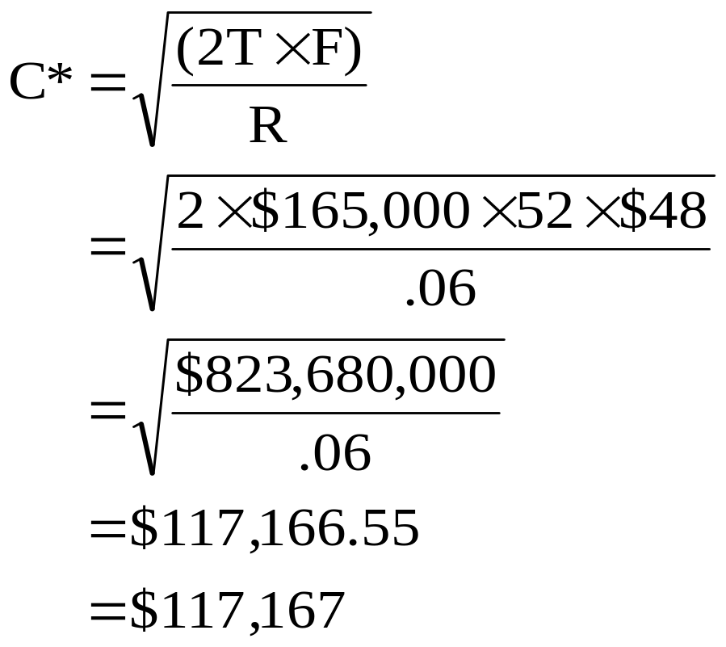
18: BAT model
What is the optimal initial cash balance?

Slide 20
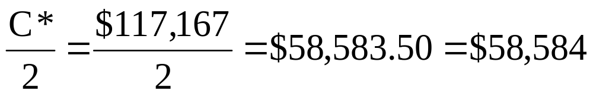
19: BAT model
What is the optimal average cash balance?
What is the opportunity cost of holding cash?

Slide 21
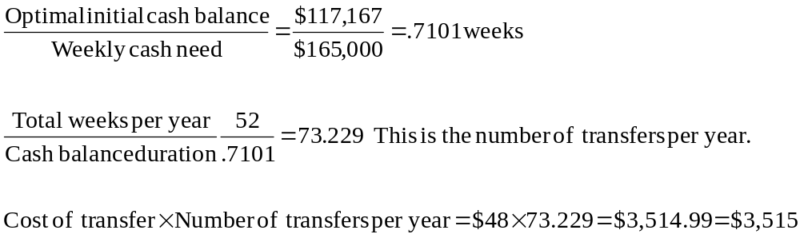
20: BAT model
What is the trading cost of holding cash?

Slide 22
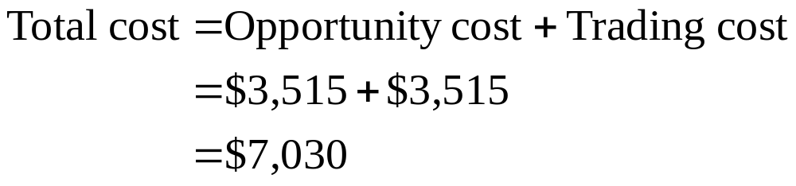
21: BAT model
What is the total cost of holding cash?

Slide 23
22: Miller-Orr model
Your firm utilizes $130,000 a week to pay bills. The standard deviation of these cash flows is $15,000. The fixed cost of transferring funds is $51 a transfer. Your firm has established a lower cash balance limit of $80,000. The weekly interest rate is .067%. Use the Miller-Orr model to answer these three questions.
What is the optimal initial cash balance?
What is the optimum upper limit?
What is the average cash balance?

Slide 24
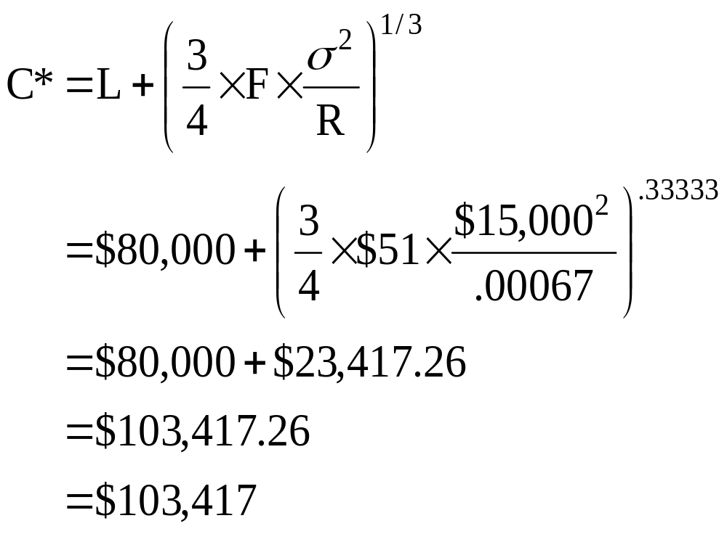
23: Miller-Orr model
What is the optimal initial cash balance?

Slide 25
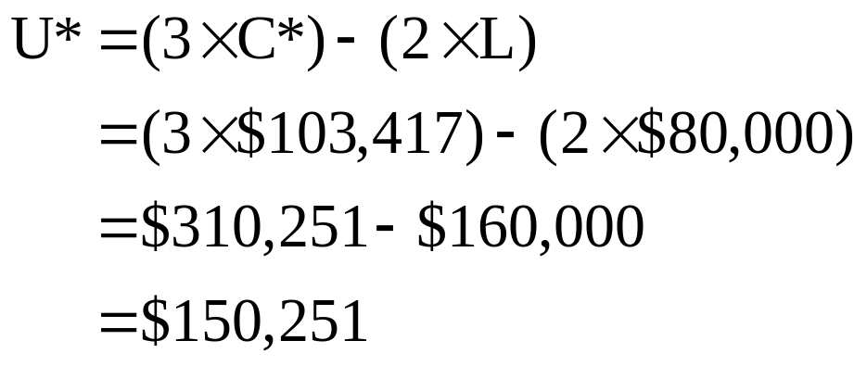
24: Miller-Orr model
What is the optimum upper limit?

Slide 26
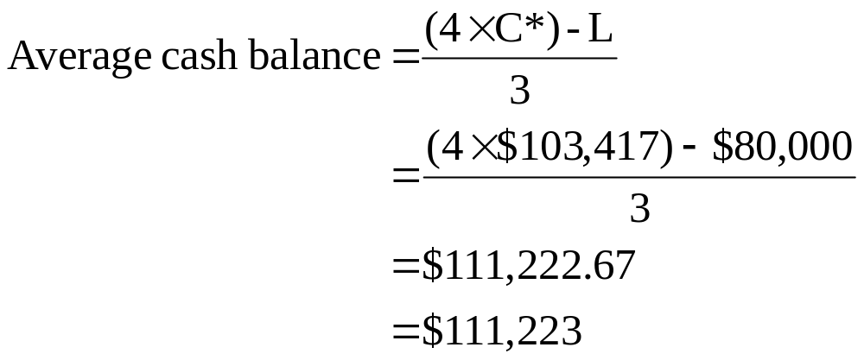
25: Miller-Orr model
What is the average cash balance?

Slide 27
20
End of Chapter 20

